Slide 1


SRI RAMAKRISHNA ENGINEERING COLLEGE
[Educational Service : SNR Sons Charitable Trust]
[Autonomous Institution, Accredited by NAAC with ‘A’ Grade]
[Approved by AICTE and Permanently Affiliated to Anna University, Chennai]
[ISO 9001:2015 Certified and all eligible programmes Accredited by NBA]
VATTAMALAIPALAYAM, N.G.G.O. COLONY POST, COIMBATORE – 641 022.
CATTLE BREED IDENTIFICATION USING DEEP LEARNING
PROJECT GUIDE TEAM MEMBERS
Dr.J.Anitha,
Asso.Professor, IT
Department of IT
Sabitha T (1805120)
Samayanjali M (1805121)
Yogapriya P (1805161)
IV B.Tech IT-B

Slide 2
CONTENTS
Abstract
Introduction
Objectives
Literature Survey
Existing System
Proposed system
Block Diagram
Modules
Datasets
Methodology
Results
Conclusion and Future Scope
References

Slide 3
ABSTRACT
Animals breeds are determined using cattle identification techniques based on their size and colour. Radio frequency, optical frequency, and ear tagging are currently used among the many alternatives available for forecasting individual cattle breeds.
A mixture of image datasets can be used to identify a cattle breed. The cattle images are significant features from the front, back, and side perspectives can be extracted and utilised to identify individual cattle.
Rare cow breeds will be classified independently using the preprocessed images dataset. Faces are recognised throughout the body of the cow image using CNN deep learning.

Slide 4
INTRODUCTION
Dairy farming is a key employment and source of landless labour. Animal breeds are intraspecific groups of animals that share a variety of features that set them apart from other breeds.
The cameras were primarily employed to detect cow activity in cattle farms, although distinguishing between livestock with similar features, particularly black and brown cattle, can be challenging.
The face and numerous shapes in the complete body of the cattle image are distinguished using the CNN deep learning approach.

Slide 5
OBJECTIVES
The goal was to capture images of cattle with a rich, dense texture.
The texture feature of the images was extracted and encoded using a convolutional neural network.
From the images, identify the individual cow.
To be used for biometric recognition of cattle.

Slide 6
LITERATURE SURVEY
No | Approach | Proposed By | Description
1 | Identification of Cattle Breed using the Convolutional Neural Network | Sreenand Manoj, Rakshith S and Kanchana V | An image of the cattle will be taken to get the prominent features of the front, rear and side view and these image dataset will be processed and according to the processed image the cattle breed will be determined.
2 | Evaluation of Deep Learning for Automatic Multi-View Face Detection in Cattle | Beibei Xu, Wensheng Wang, Leifeng Guo, Guipeng Chen | This approach evaluated the possibility of the cutting-edge object detection algorithm, RetinaNet, performing multi-view cattle face detection in housing farms with fluctuating illumination, overlapping, and occlusion.

Slide 7
LITERATURE SURVEY
No | Approach | Proposed By | Description
3 | Cattle Identification Using LBP Descriptor And SVM Classifier | Supriya Rajankar, Rahul Mankar, Omprakash Rajankar | In order to implement positive cattle identification delectability, the paper proposes a new model dependent on the histogram of Gradients (HOG) and Convolution Neural Networks (CNN). Training algorithm was applied separately on a number of normalized gray faces of cattle images.
4 | Individual Cattle Identification Using a Deep Learning Based Framework | Yongliang Qiao, Daobilinge Su, He Kong, Salah Sukkarieh, Sabrina Lomax and Cameron Clark | A CNN network was used to extract features from a rear-view cattle video dataset and these extracted features were then used to train an LSTM model to capture temporal information and identify each individual animal.

Slide 8
EXISTING SYSTEM
The identification of cattle is an emerging research field in computer vision, pattern recognition, animal biometrics, and cognitive science. It is getting more proliferation due to a wide range of applications and uses for identification of individual animals, development of traceability system for cattle
This approach makes use of Local Binary Pattern (LBP), Convolution Neural Network (CNN) and Support Vector Machine (SVM) for cattle identification to extract local invariant features from cattle images.

Slide 9
PROPOSED SYSTEM
We acquired around 150 cattle picture datasets for our proposed system, which were then preprocessed to transform them to a specific dimension. Then, using the SIFT approach, the distinct bodily sections of the cattle were retrieved.
Finally, we used CNN to divide the cattle into 13 classes and forecast their breed. Only when the image of the cattle is a complete single animal will this proposed technique work.
Future work will include identifying cattle in images with other animals. Separation of cow breeds in the image.

Slide 10
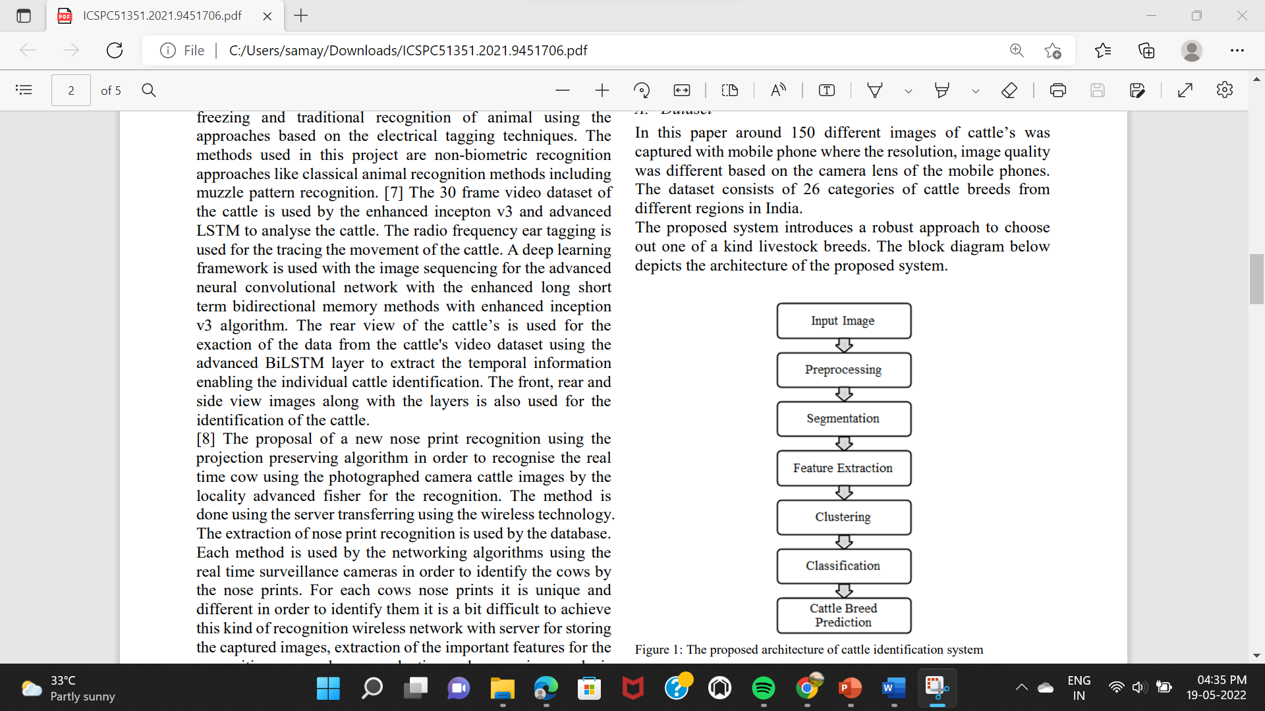
BLOCK DIAGRAM

Slide 11
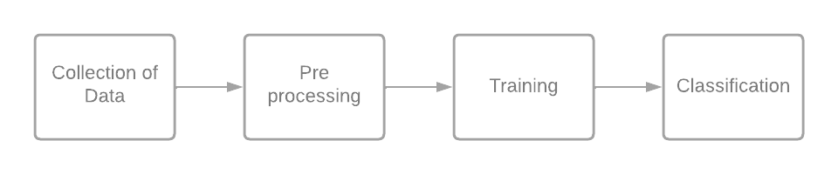
MODULES
Notes:
Deep Learning techniques

Slide 12
MODULES
Collection of data
The Dataset is collected from several images around 150 different images of cattle’s was captured and it consists of 13 categories of cattle breeds from different regions in India.
Importing the datasets and preprocessing
The dataset was loaded into the GUI. The undesirable parts of the image are deleted during pre-processing. The cattles are identified using the CNN approach.
Notes:
Deep Learning techniques

Slide 13
MODULES
Training
After pre-processing, the dataset is trained using convolutional architecture is utilised to determine a specific area or region directly. This approach is mostly used to segment image pixel values. After the cattle image has been transformed to grey scale, the image is classified into its specific number of classes.
Classification
CNN is the most commonly utilised domain that provides the best level of accuracy and classify the image using the CNN algorithm after extracting the features because CNN uses minimum knowledge of the training data. To trained the CNN model. Each method is carried out for individual cow, and the breed is identified and detected as a result.
Notes:
Deep Learning techniques

Slide 14
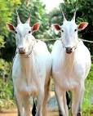
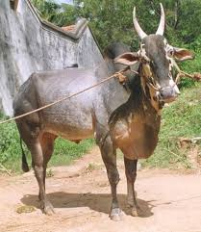
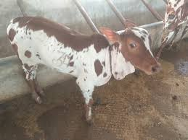
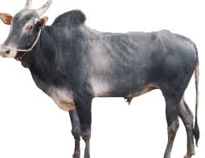
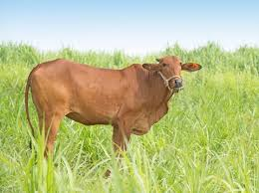
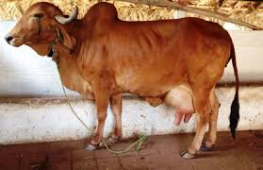
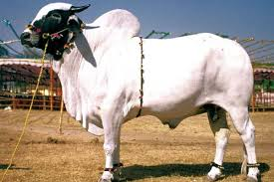
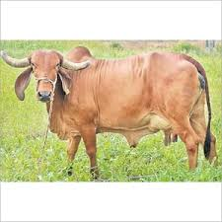
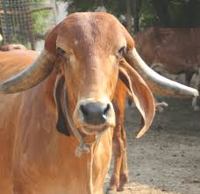
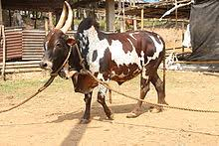
DATASETS
Image datasets of different breeds of cattle have been collected and the sample of the datasets is given below
Figure 1 – Datasets

Slide 15
METHODOLOGY
Input Images
This is the first step in the cattle identification system, in which over 150 images of various cows were taken in various locations of India.
Pre-Processing
The quality of the images was diverse due to the multiple cameras used to collect the images, this step was done after the image was loaded to the GUI as a through preparation of the images. The resolution of the photos was first increased to 247*247 pixels throughout this process. The image’s interrupts are removed during pre-processing. The CNN method is used to increase visual contrast.

Slide 16
METHODOLOGY
Convolutional Neural Network
The Convolutional Neural Network (CNN) deals with the set of data to extract information .
The model is trained in such a way that when the input is given, the data is pre-processed and the feature is extracted on the basis of the set of stored data and the classification is done.
The CNN deep learning technique is used to accelerate the training of deep neural networks and take advantage of the multi-scale structure of the image pattern of cattle for cattle recognition

Slide 17
METHODOLOGY
SEGMENTATION
Segmentation is a technique for grouping pixels into compact representations to determine a specific area or territory.
This approach is mostly used to segment image pixel values. The seed points (Initial) of a picture are used to segment the image.
After the cattle image has been transformed to grey scale, the image is classified into its specific number of classes. The cattle image was segmented stage by stage.
The foreground and background of the cattle image are split independently at each level. The cattle's body parts will be segmented individually in the final stage.

Slide 18
METHODOLOGY
Feature Extraction
Feature extraction is crucial. It's useful when you need to process larger groups more quickly. To extract local features of the cattle – horn, ear, and skin.
The scale-invariant feature transform (SIFT) algorithm is applied. Each specific portion of the animal will be removed one by one. Using SIFT techniques are used to extract information from the cattle image.
In order to recognise essential features such as body component feature extracted points based on the local feature extracted values from the cattle image.

Slide 19
METHODOLOGY
Classification and Cattle Breed Prediction
Convolutional neural networks can be considered the mainstream classifier for classifying images in the deep neural network paradigm. CNN is the most commonly utilised domain for accuracy.
After extracting the characteristics, we apply the CNN algorithm to classify the image. We built and trained the CNN model to classify cattle photos.
Each operation is carried out for individual cattle, and the breed classification and detection

Slide 20
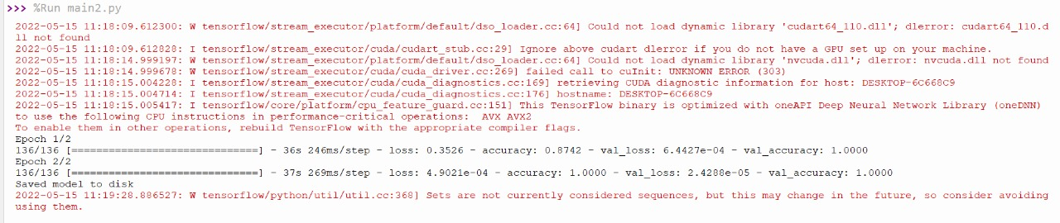
RESULTS
Fig 1. Training and accuracy

Slide 21
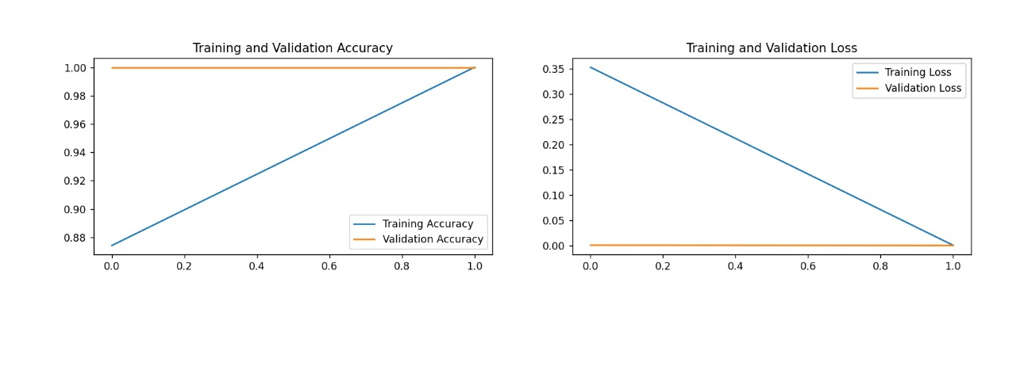
RESULTS
Fig 2. Graphical representation of training an validation accuracy and loss

Slide 22

RESULTS
Fig 3. Python GUI Representation

Slide 23
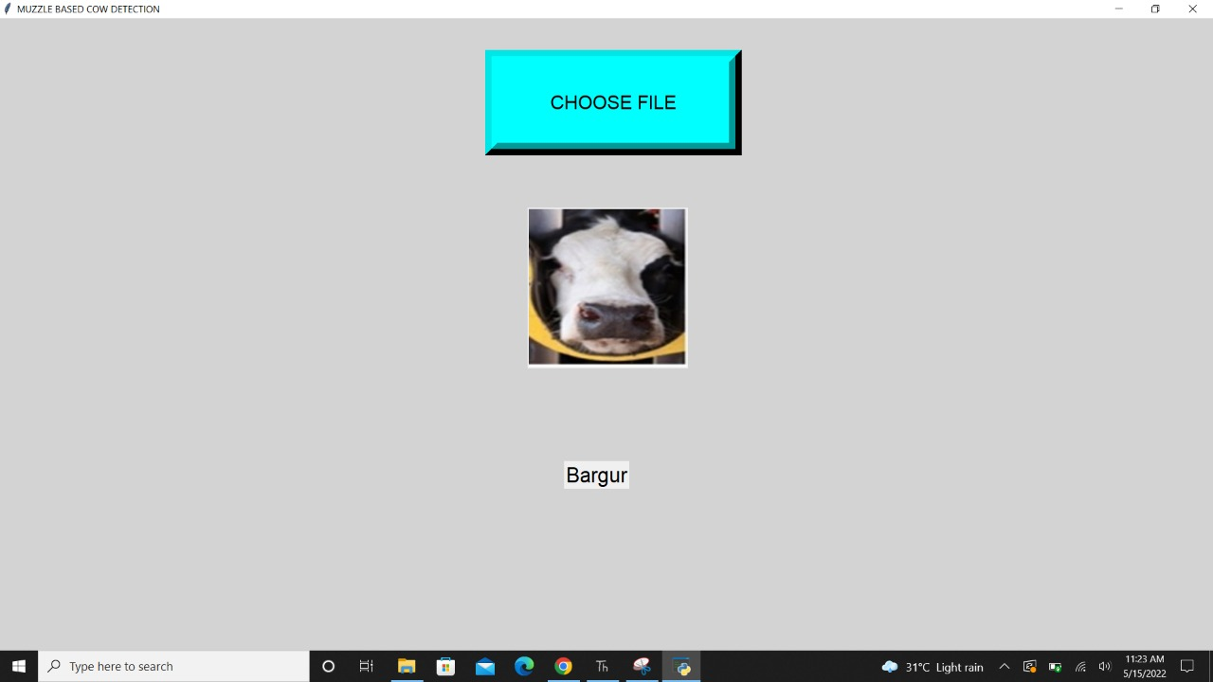
RESULTS
Fig 4. Cattle detection - Bargur

Slide 24
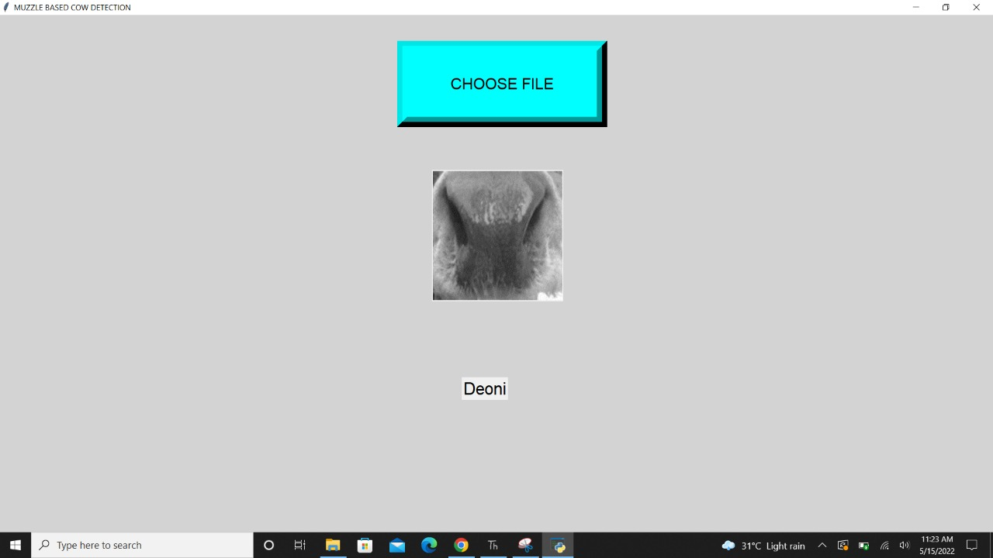
RESULTS
Fig 5. Cattle detection - Deoni

Slide 25
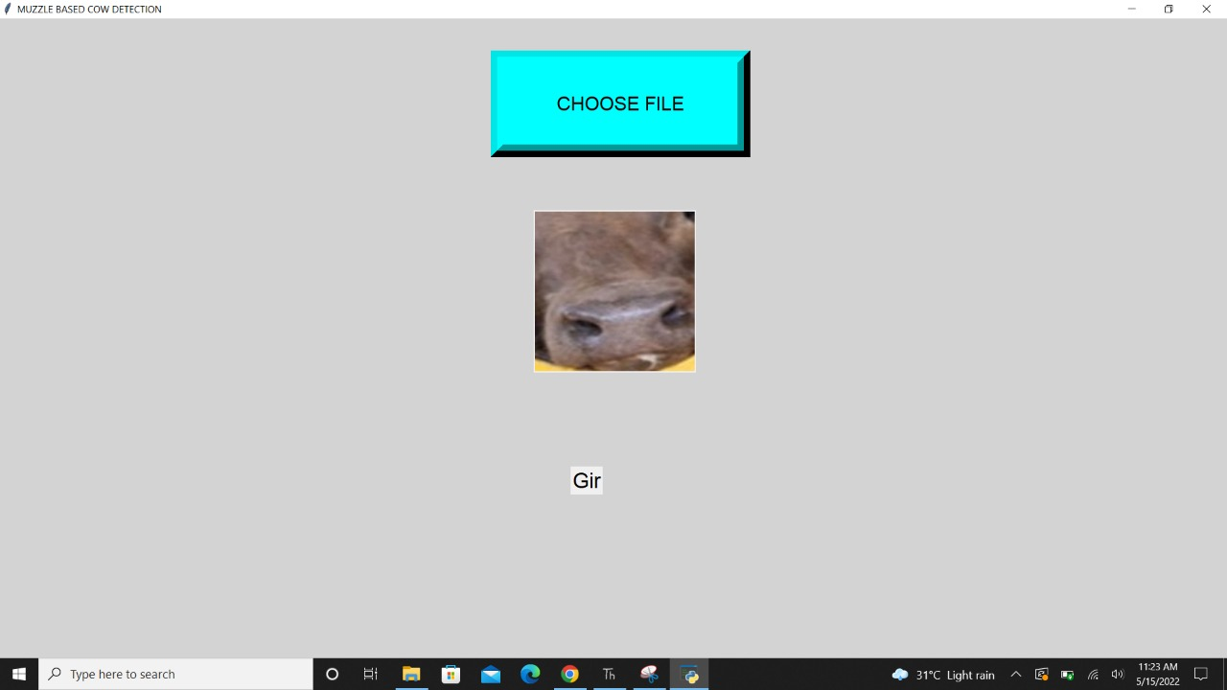
RESULTS
Fig 6. Cattle detection - Gir

Slide 26
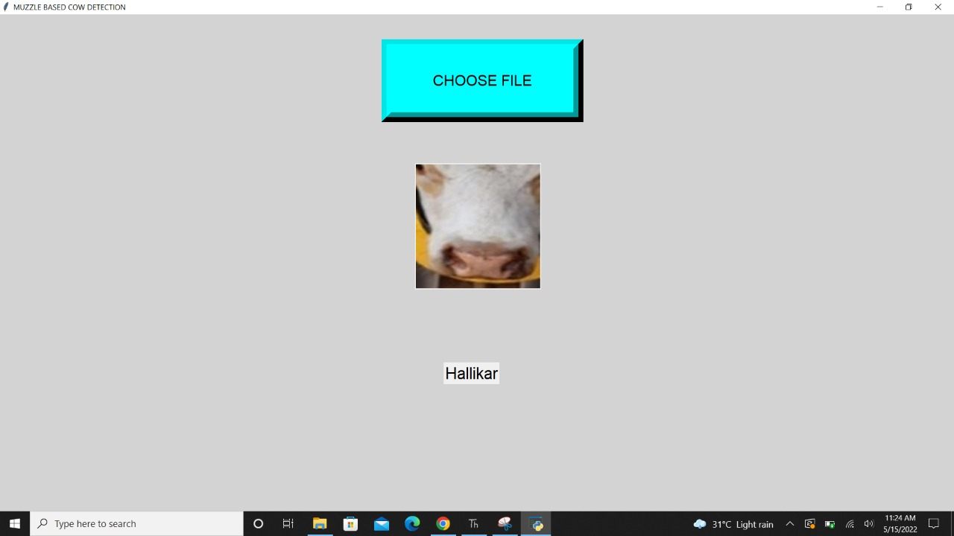
RESULTS
Fig 7. Cattle detection - Halikar

Slide 27

RESULTS
Fig 8. Cattle detection - Kangayam

Slide 28
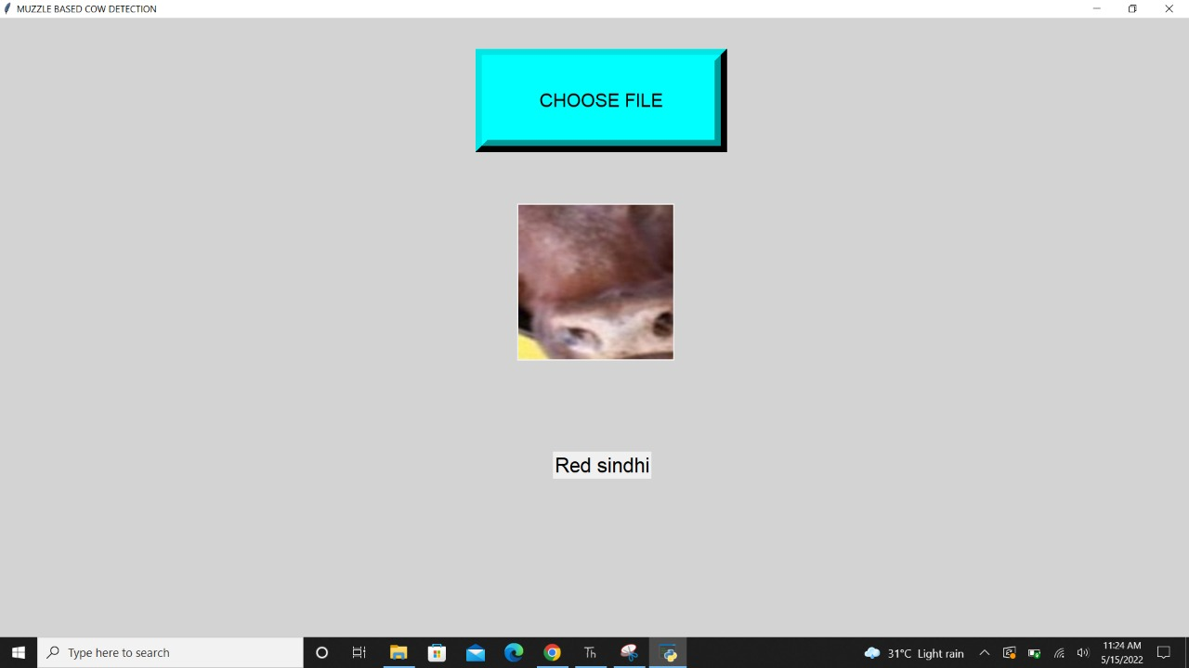
RESULTS
Fig 9. Cattle detection – Red sindhi

Slide 29
CONCLUSION AND FUTURE SCOPE
We collected over 150 cattle picture datasets for our suggested system, and these photos were preprocessed to transform them to a specific dimension and reduce noise.
After that, used the SIFT method to extract features, and The cattle's various body parts were extracted. Finally, we categorized CNN was used to divide the animals into 13 classes and forecast the breed.
Only when the image of the cattle is visible does this proposed system work a single entire animal Identification of cattle in the future diverse backdrops with other animals in the images. Further livestock separation where the image consists Cattle of several breeds.
As a result, the image pattern ensures both efficiency and animal welfare in cow farms.

Slide 30
REFERENCES
Okura, F., Ikuma, S., Makihara, Y., Muramatsu, D., Nakada, K., and Yagi, Y. (2019). RGB- D video-based individual identification of dairy cows using gait and texture analyses. Comput. Electron. Agric. 165:104944. doi: 10.1016/j.compag.2019.104944.
Alberto, R., C. Pablo, G.-B. Alfonso, and C. Juan. 2018. “Detection Of Cattle Using Drones and Convolutional Neural Networks.” Sensors 18 (7): 2048.
Chen, Y., Z. Wang, Y. Peng, Z. Zhang, Y. Gang, and J. Sun. 2018. “Cascaded Pyramid Network for Multi-person Pose Estimation.” Paper presented at the Proceedings of the IEEE Conference on Computer Vision and Pattern Recognition, Salt Lake City,USA.
S. Kumar, S. Chandrakar, A. Panigrahi and S. K. Singh, "Muzzle point pattern recognition system using image pre-processing techniques," 2017 Fourth International Conference on Image Information Processing (ICIIP), 2017, pp. 1-6, doi: 10.1109/ICIIP.2017.8313697.
W. Kusakunniran, A. Wiratsudakul, U. Chuachan, S. Kanchanapreechakorn and T. Imaromkul, "Automatic cattle identification based on fusion of texture features extracted from muzzle images," 2018 IEEE International Conference on Industrial Technology (ICIT), 2018, pp. 1484-1489, doi: 10.1109/ICIT.2018.8352400.
T. T. Zin et al., "Cow Identification System using Ear Tag Recognition," 2020 IEEE 2nd Global Conference on Life Sciences and Technologies (LifeTech), 2020, pp. 65-66, doi: 10.1109/LifeTech48969.2020.1570625232.

